Slide 1


Events
Chris Piech
CS106A, Stanford University

Slide 2
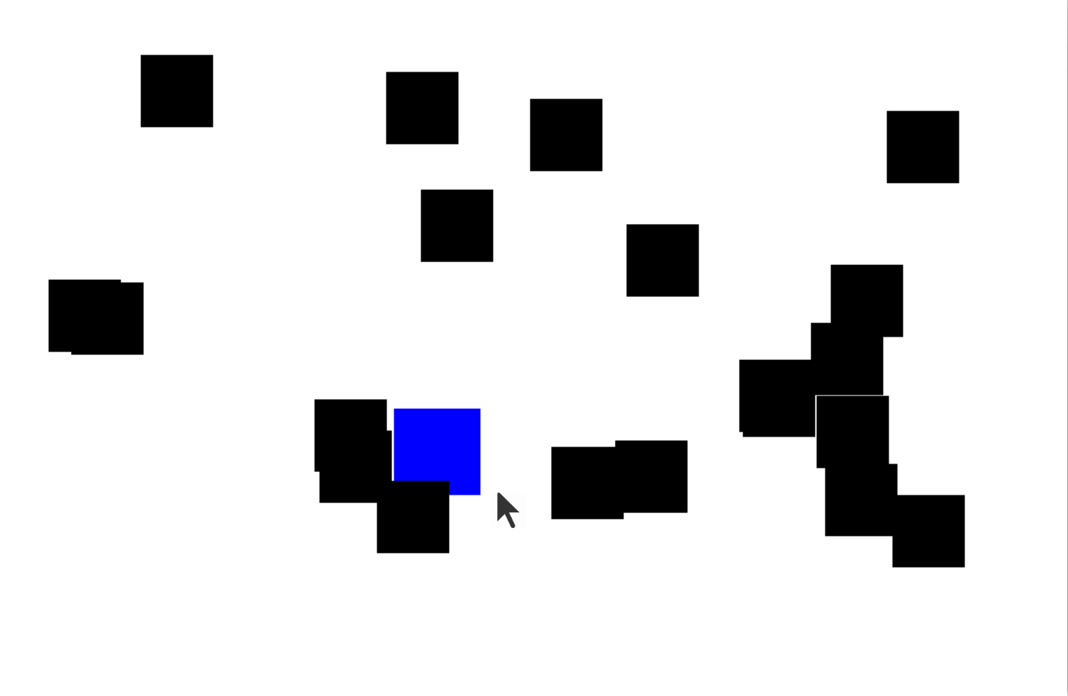
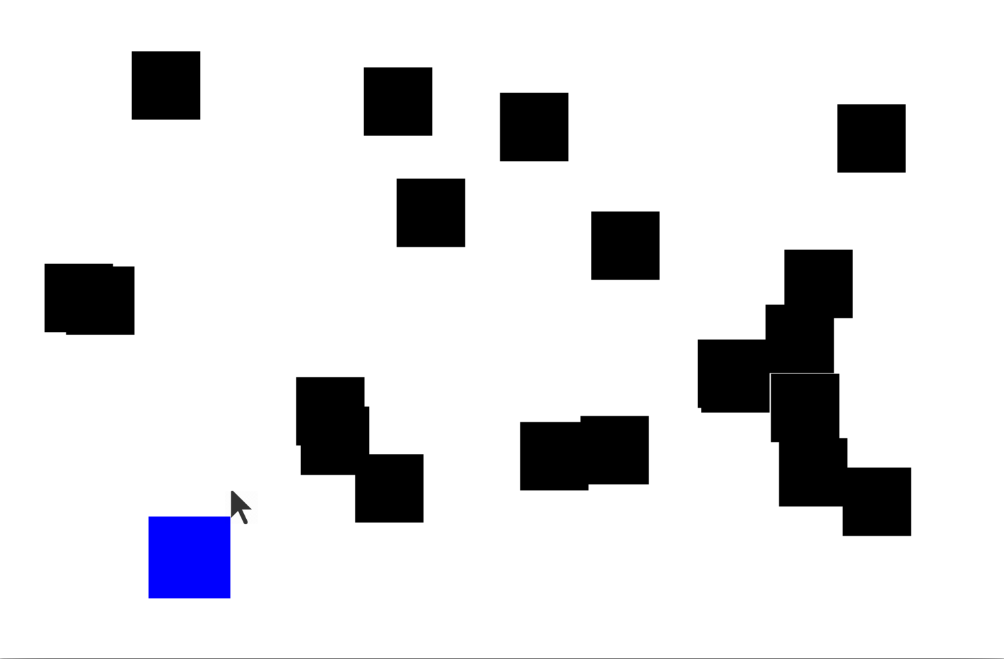
Catch Me If You Can

Slide 3
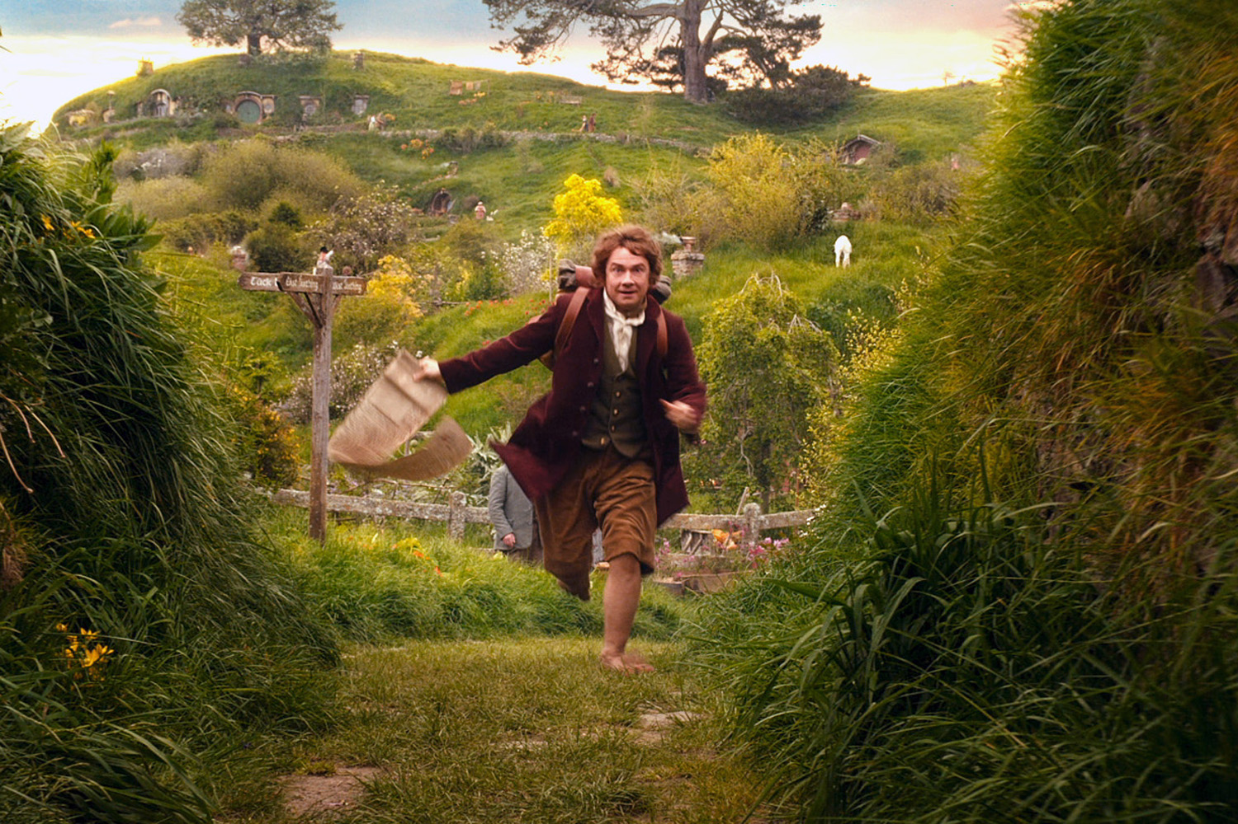
We’ve Gotten Ahead of Ourselves
Source: The Hobbit

Slide 4
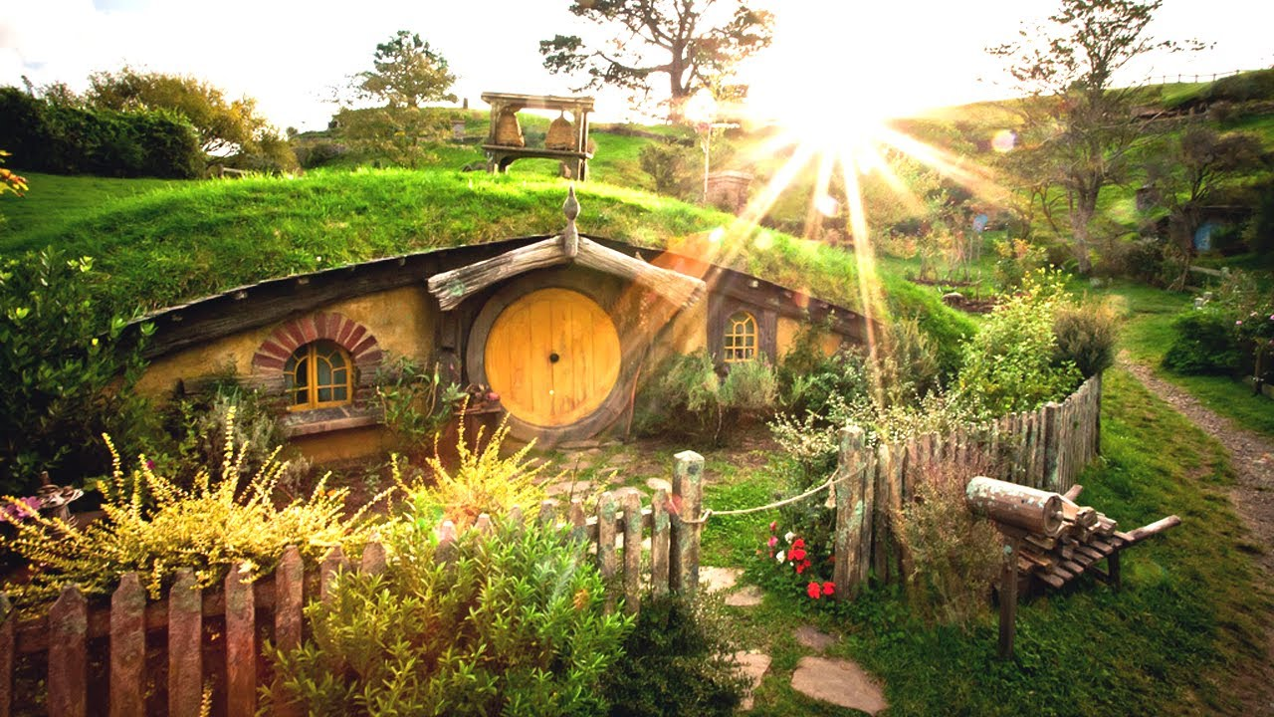
Start at the Beginning
Source: The Hobbit

Slide 5

Learning Goals
Write a program that can respond to mouse events
Use an instance variable in your program

Slide 6
Novelty
New Commands
rg.nextInt(max);
addMouseListeners();
getElementAt(x, y);
remove(obj);
New Ideas
The Listener Model
Instance Variables
null

Slide 7
Random Numbers
// this variable can make random numbers
RandomGenerator rg = new RandomGenerator();
// make a random number between 0 and 5
int randNum = rg.nextInt(6);

Slide 8

Random Numbers Theory
Last random number
Next random number
// actual code from the java library
int nextseed = (oldseed * multiplier + addend) % max;
Fun fact: the first random number comes from the CPU clock
* Just for fun. Not on exams or psets…

Slide 9
Random Numbers
// this variable can make random numbers
RandomGenerator rg = new RandomGenerator();
// now each run will be the same…
rg.setSeed(0);
// make a random number between 0 and 5
int randNum = rg.nextInt(6);

Slide 10
Catch Me If You Can

Slide 11
Mouse Events
public void run() {
// Java runs this when program launches
}
public void mouseClicked(MouseEvent event) {
// Java runs this when mouse is clicked
}
public void mouseMoved(MouseEvent event) {
// Java runs this when mouse is moved
}
Notes:
these new methods also have to be specifically named.
Just like run, these methods are called by Java, not by our code!

Slide 12
The Listener Model
public void run() {
// 1. add mouse listeners
addMouseListeners();
}
public void mouseClicked(MouseEvent event) {
// Java runs this when mouse is clicked
}
public void mouseMoved(MouseEvent event) {
// Java runs this when mouse is moved
}
Notes:
these new methods also have to be specifically named.
Just like run, these methods are called by Java, not by our code!

Slide 13
The Listener Model
public void run() {
// 1. add mouse listeners
addMouseListeners();
}
public void mouseClicked(MouseEvent event) {
// Java runs this when mouse is clicked
}
public void mouseMoved(MouseEvent event) {
// Java runs this when mouse is moved
}
Notes:
these new methods also have to be specifically named.
Just like run, these methods are called by Java, not by our code!

Slide 14
Examples

Slide 15
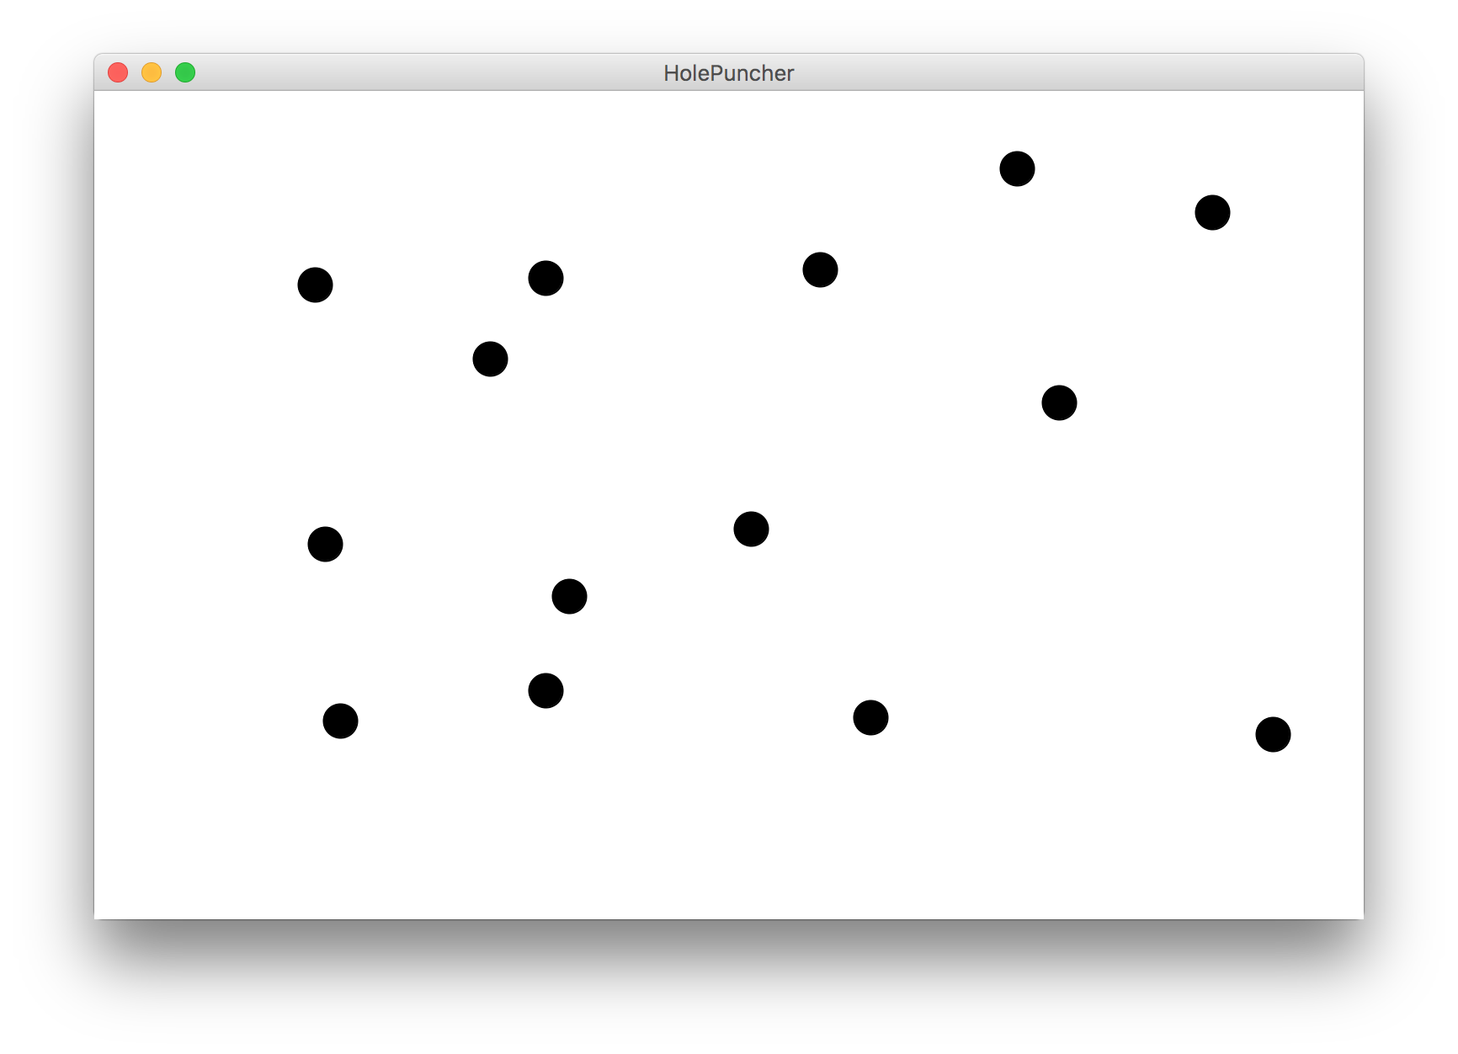

Hole Puncher

Slide 16
Now With Dancing Children

Slide 17

Normal Program
Run Method

Slide 18
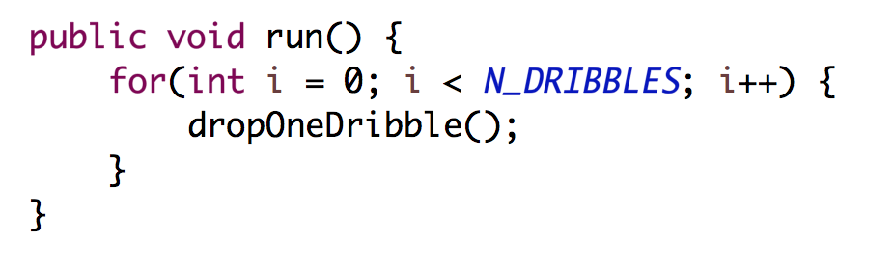
Normal Program
Run Method
public void run() {
while(true) {
update();
pause(DELAY);
} }

Slide 19
Normal Program
Run Method
public void run() {
while(true) {
update();
pause(DELAY);
} }

Slide 20
Normal Program
Run Method
public void run() {
while(true) {
update();
pause(DELAY);
} }

Slide 21
Normal Program
Run Method
public void run() {
while(true) {
update();
pause(DELAY);
} }

Slide 22
Normal Program
Run Method
public void run() {
while(true) {
update();
pause(DELAY);
} }

Slide 23
Normal Program
Run Method

Slide 24


New Listener Characters
Mouse Listener
Mouse Moved Method

Slide 25
Program with a Mouse Method
Run Method
Mouse Moved Method

Slide 26
Program Starts Running
Run Method
Mouse Moved Method

Slide 27
Add Mouse Listener
Run Method
Mouse Moved Method
Mouse Listener
addMouseListeners();

Slide 28
Program Runs as Usual
Run Method
Mouse Moved Method
Mouse Listener

Slide 29

Mouse Moved!
Run Method
Mouse Moved Method
Mouse Listener

Slide 30
Calls Mouse Moved Method
Run Method
Mouse Moved Method
Mouse Listener

Slide 31
When done, Run continues.
Run Method
Mouse Moved Method
Mouse Listener

Slide 32
Keeps Doing Its Thing…
Run Method
Mouse Moved Method
Mouse Listener

Slide 33
Mouse Moved!
Run Method
Mouse Moved Method
Mouse Listener

Slide 34
Calls Mouse Moved Method
Run Method
Mouse Moved Method
Mouse Listener

Slide 35
When done, Run continues.
Run Method
Mouse Moved Method
Mouse Listener

Slide 36

Mouse Tracker

Slide 37
Mouse Tracker

Slide 38
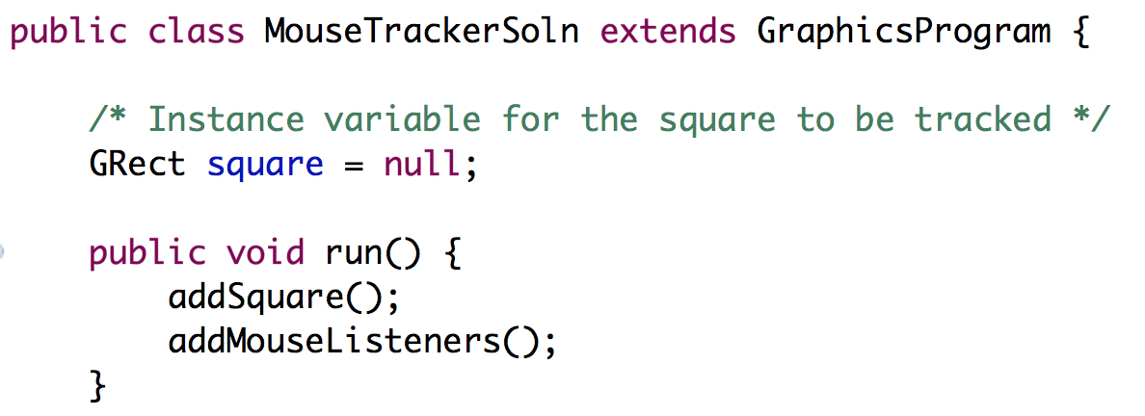
Instance Variables
Variables exist until their inner-most control block ends.
If a variable is defined outside all methods, its inner-most control block is the entire program!
We call these variables instance variables
/* Instance variable for the square to be tracked */
private GRect square = null;
public void run() {
square = makeSquare();
addSquareToCenter();
addMouseListeners();
}
* Instance variables have special meanings in programs with multiple files. For now you need to know that all methods can see them and that their initialization line is executed before run.

Slide 39
Instance Variables + Events
Often you need instance variables to pass information between the run method and the mouse event methods!
/* Instance variable for the square to be tracked */
private GRect square = null;
public void run() {
square = makeSquare();
addSquareToCenter();
addMouseListeners();
}
public void mouseMoved(MouseEvent e) {
int x = e.getX() - SQUARE_SIZE/2;
int y = e.getY() - SQUARE_SIZE/2;
square.setLocation(x, y);
}

Slide 40
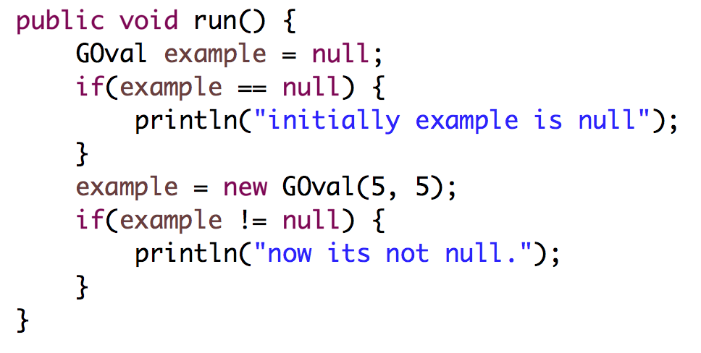
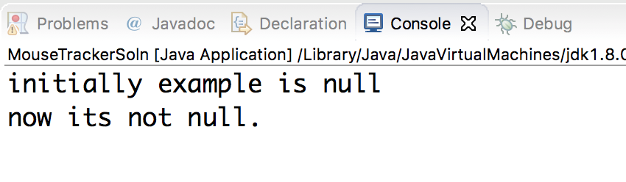
Null
Objects have a special value called null which means this variable is not associated with a value yet.

Slide 41
getElementAt

Slide 42
getElementAt
GObjects returned by getElementAt might be null!
// may be a GObject, or null if nothing at (x, y)
GObject maybeAnObject = getElementAt(x, y);
if (maybeAnObject != null) {
// do something with maybeAnObject
} else {
// null – nothing at that location
}
Notes:
This is how we can finish dribbleCastle!

Slide 43
Null
Calling methods on an object that is null will crash your program!
// may be a GObject, or null if nothing at (x, y)
GObject maybeAnObject = getElementAt(x, y);
if (maybeAnObject != null) {
int x = maybeAnObject.getX(); // OK
} else {
int x = maybeAnObject.getX(); // CRASH!
}
Notes:
Think about null like an “invalid mailing address” – if you try to send messages to it, your messages bounce because the address is invalid

Slide 44
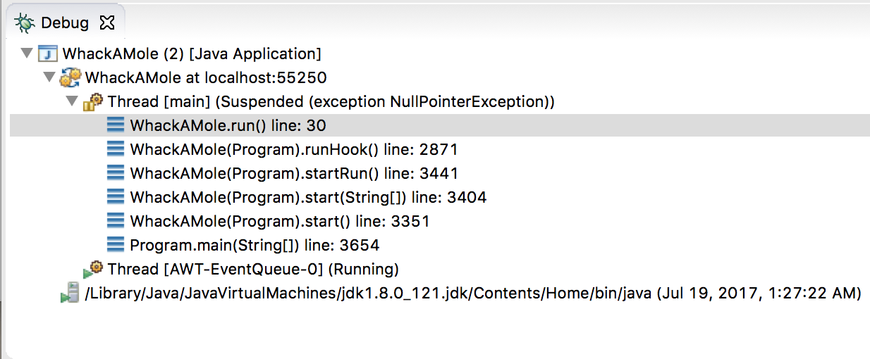
Null
Calling methods on an object that is null will crash your program! (throws a NullPointerException)

Slide 45
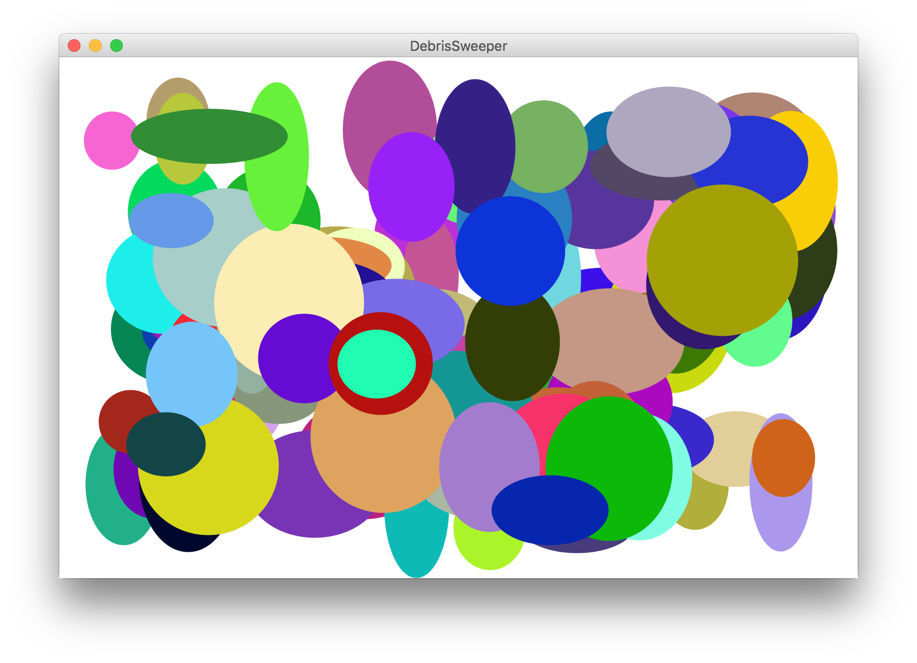
Debris Sweeper

Slide 46
Novelty
New Commands
rg.nextInt(max);
addMouseListeners();
getElementAt(x, y);
remove(obj);
New Ideas
The Listener Model
Instance Variables
null

Slide 47
Responding to Mouse Events
1. The run method should call addMouseListeners
2. Write definitions of any listener methods needed
mouseClicked( e)
Called when the user clicks the mouse
mousePressed( e)
Called when the mouse button is pressed
mouseReleased(e)
Called when the mouse button is released
mouseMoved(e)
Called when the user moves the mouse
mouseDragged(e)
Called when the mouse is dragged with
the button down
The parameter e is MouseEvent object, which provides more data about event, such as the location of mouse.
Using portions of slides by Eric Roberts

Slide 48
Responding to Keyboard Events
1. The run method should call addKeyListeners
2. Write definitions of any listener methods needed
keyPressed( e)
Called when the user presses a key
keyReleased( e)
Called when the key comes back up
keyTyped(e)
Called when the user types
(presses and releases) a key
The parameter e is a KeyEvent object, which indicates which key is involved.
Using portions of slides by Eric Roberts

Slide 49
And Here We Are…

Slide 50
Catch Me If You Can?

